Slide 1
The Word Blind Centre and the campaign for recognition of dyslexia
UK Dyslexia Archive
St John’s College, Oxford

Slide 2
UK Dyslexia Archive: A new project
Based at St John’s College and the Faculty of History, University of Oxford
Collaboration between history, psychology, geography
Maggie Snowling, William Whyte, Kate Nation, Kieran Fitzpatrick, Philip Kirby, with the support of Robert Evans, Denise Cripps
Started in 2014; funded by Wellcome Trust/ John Fell award (2016-18)
Collection includes patient files of the Word Blind Centre, files of the BDA, DI, Helen Arkell Centre, amongst others
Oral histories with dyslexia pioneers and others key to the story of dyslexia

Slide 3
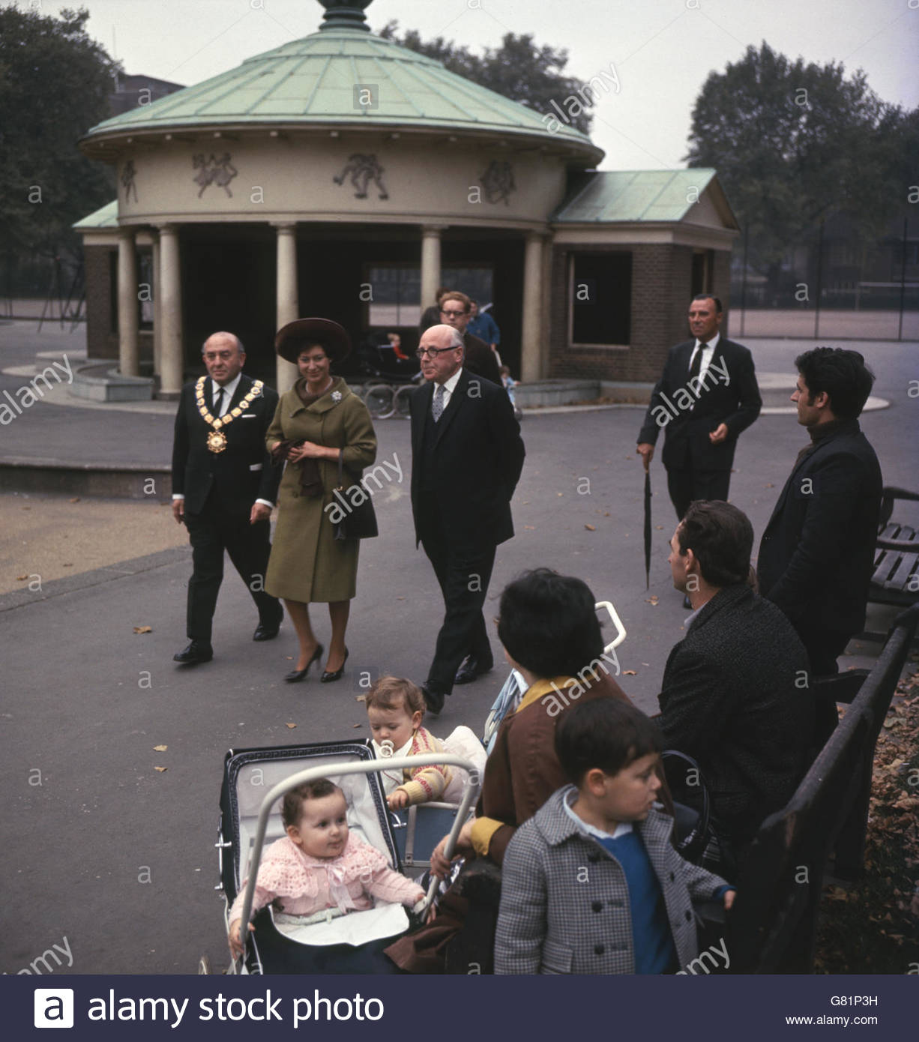
The Word Blind Centre (1963-1972)
Opened by Princess Margaret in Coram’s Fields, Bloomsbury (pictured)
Research interest in Britain beginning to coalesce (or coalesce again)
Founded by the Invalid Children’s Aid Association (ICAA)
Committee members: Macdonald Critchley, Patrick Meredith, Tim Miles, Maisie Holt, Oliver Zangwill
Chairman: Alfred White Franklin, who was also chair of the ICAA
First director, Alex Bannatyne; later, Sandhya Naidoo, who served until its closure

Slide 4
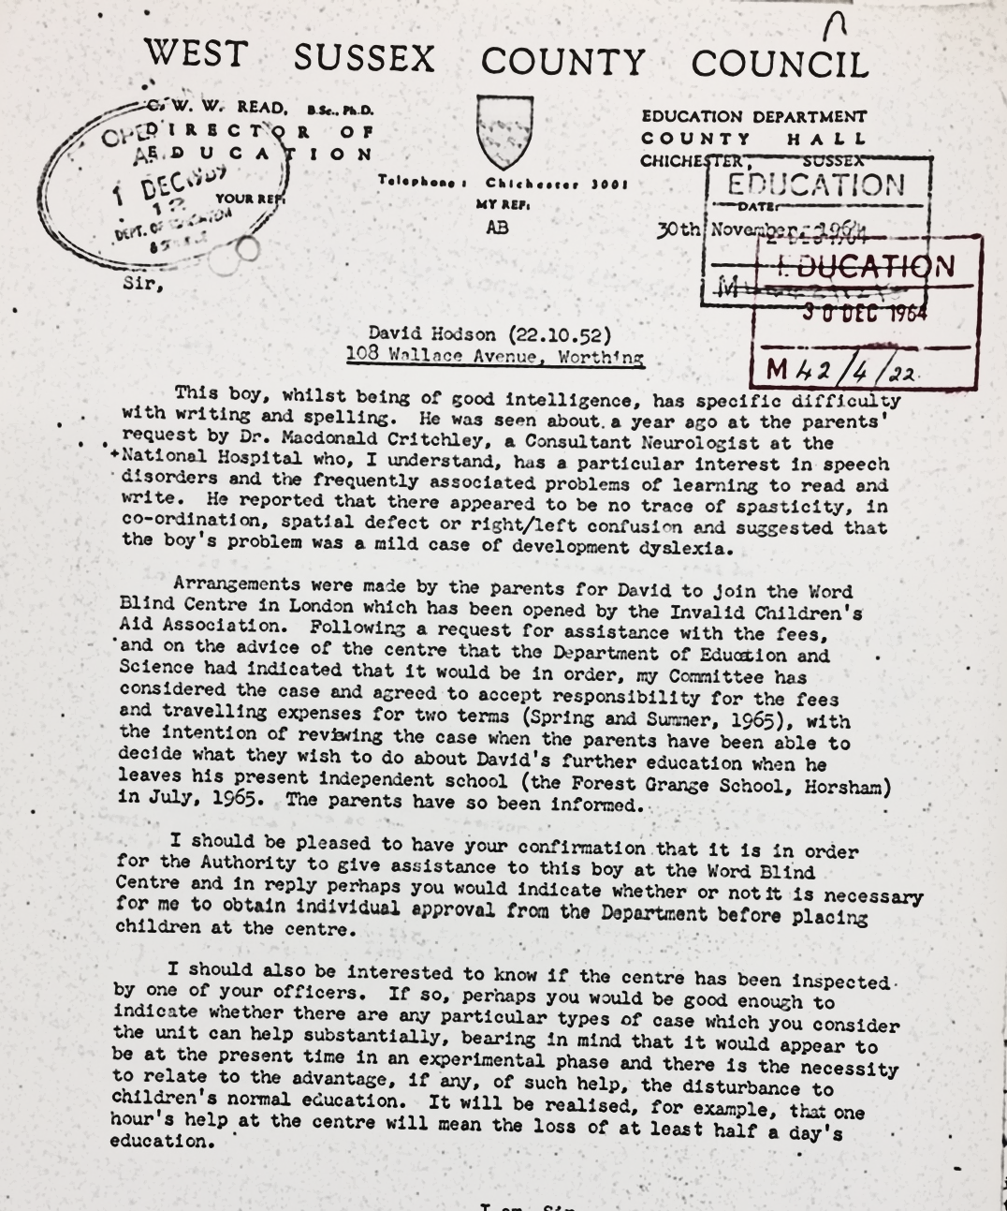
The Word Blind Centre, class and LEAs
Late 1964, West Sussex County Council fund pupil to attend the Centre. Other LEAs do the same
‘I should be pleased to have your confirmation that it is in order for the Authority [West Sussex County Council] to give assistance to this boy at the Word Blind Centre’ (West Sussex County Council)
From one of the patient files: ‘Father can’t read & mother is apt to pin all the blame of children’s backwardness onto Dad. Mother is resentful of any suggestion that her children are not normal. With an I.Q. of about 94, I feel that something other than low intelligence is preventing him from reading’

Slide 5
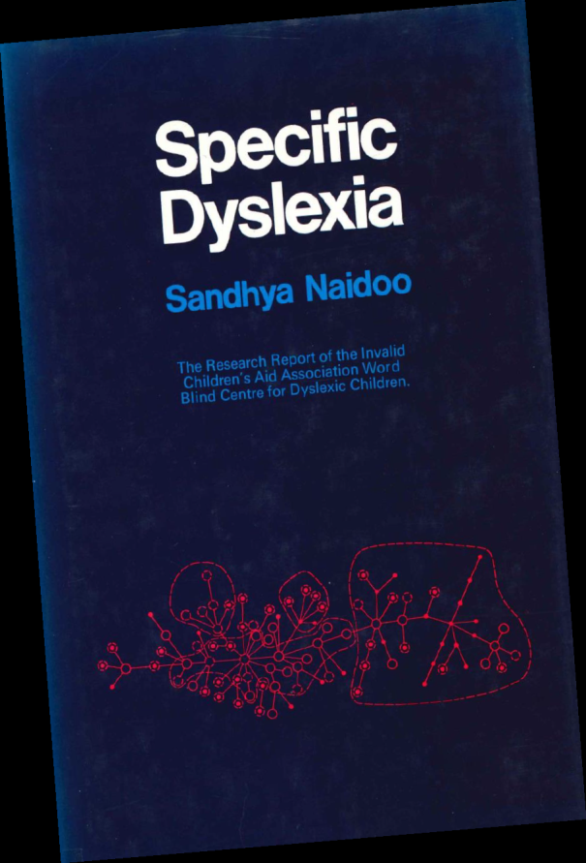
The Word Blind Centre, research and legacies
‘Many features indicative of developmental delay have been found to distinguish the dyslexics from their controls. But only the specific reading and spelling retardation is common to all. The finding that there is no other defect in all these dyslexics is in keeping with the results of previous investigations’ (Naidoo, Specific Dyslexia)
‘The arguments in favour of the existence of a specific type of developmental dyslexia occurring in the midst of but nosologically apart from the olla podrida of bad readers’ (Critchley, The Dyslexic Child)
‘I think that book [Naidoo’s] was the book that was most illuminating at the time, because it described cases in detail… she’d made a detailed analysis of those kids, and I think I was really inspired by that’ (Maggie Snowling)

Slide 6
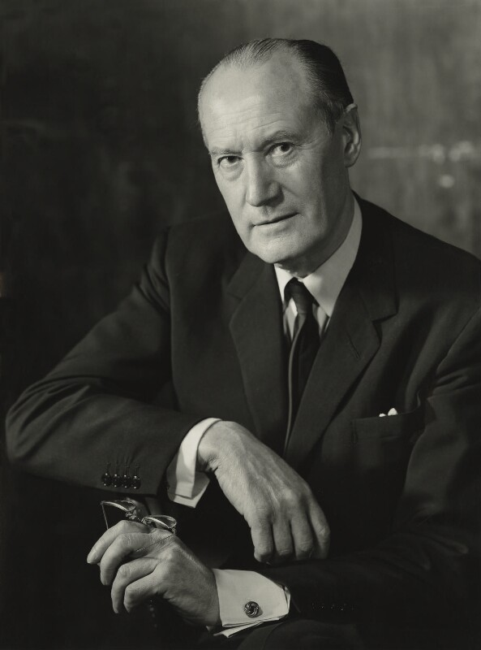
The Word Blind Centre and education policy
From the Word Blind Centre: Alfred White Franklin, Macdonald Critchley (pictured), Patrick Meredith
From the Ministry of Education: Dr JN Horne (Medical Officer)
‘It is quite correct to understand that I am still “sitting on the fence”, for this survey is not yet complete… I have been surprised at the depth of feeling expressed about some of the terms’ (Horne in reply to White Franklin)
‘I pressed Professor Meredith as to whether he held the view that reading delay existed in a varying degree of severity, or whether at the most severe grade were a group of children who had distinctive features whereby they could be called “specific dyslexia.’ He replied that he held the latter view. I replied that amongst the 350 children that I had seen I found no evidence to support this view. Professor Meredith replied that these children were undoubtedly very rare’ (Horne in dialogue with Meredith)

Slide 7
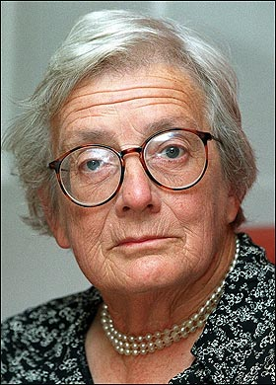
The Warnock Report on SEN (1978)
‘The hostility in the department of this concept was manifested by the instruction we were given when we were set up at the beginning of ’74 when I was summoned by the person in the Department who was responsible for the committee… He said, ‘You should not suggest that there is a special category of learning difficulty called dyslexia’
First use of the term ‘special educational needs’
Influenced by landmark research on reading difficulties from the Isle of Wight studies (1964-1974), led by Mike Rutter and Bill Yule
Later, the government used the Warnock Report’s disinclination toward grouping children to stall parliamentary questions, saying that they could not, as such, recognise the particular category of ‘dyslexic children’

Slide 8
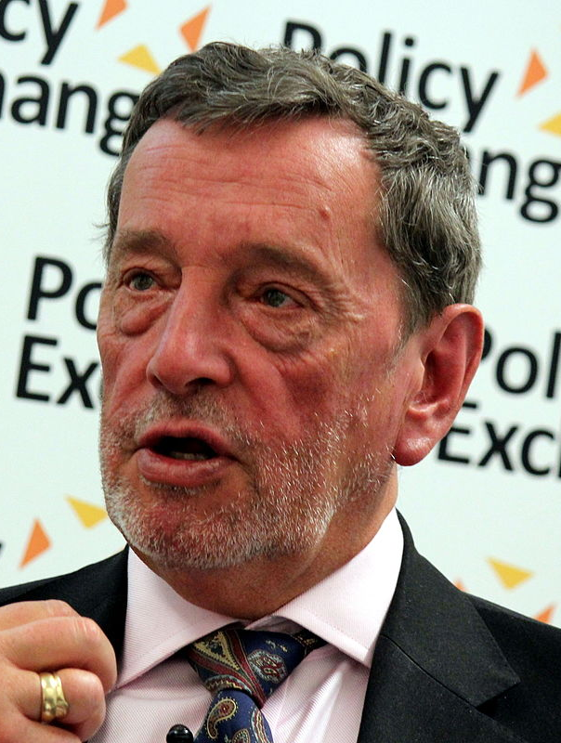
Increasing support for children (1980-1990s)
The advent of neoliberal agendas in education and the rise of the ‘A-C economy’ (Gillborn and Youdell, 2000)
‘We were in a quite powerful position. We’d got a massive majority, the commitment of the Prime Minister, someone who himself had been to a special school with at least two sons who’d experienced this particular specific educational need, a very understanding ministerial team, and we’d got Michael Barber heading the standards unit – so it was quite formidable for people to take it head on’ (Interview w/ David Blunkett, 2017)
Protections for dyslexia enshrined in the 2010 UK Equality Act

