Slide 1
Worried mothers? Oral history, gender and the ‘dyslexia myth’
UK Dyslexia Archive
St John’s College, Oxford

Slide 2
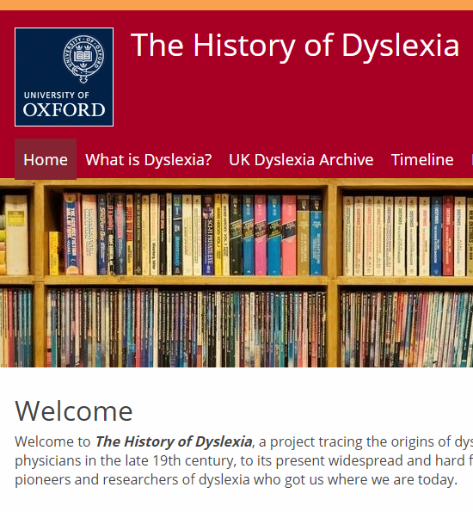
The UK Dyslexia Archive project
Based at St John’s and the Faculty of History, Oxford
Collaboration between history, psychology, geography
Maggie Snowling, William Whyte, Kate Nation, Kieran Fitzpatrick, Robert Evans, Denise Cripps
Started in 2014; Wellcome Trust/ John Fell award (2016-18)
Collection includes patient files of the Word Blind Centre, files of the BDA, DI, Helen Arkell Centre
Oral histories with dyslexia pioneers and others key to its story

Slide 3
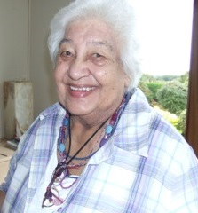
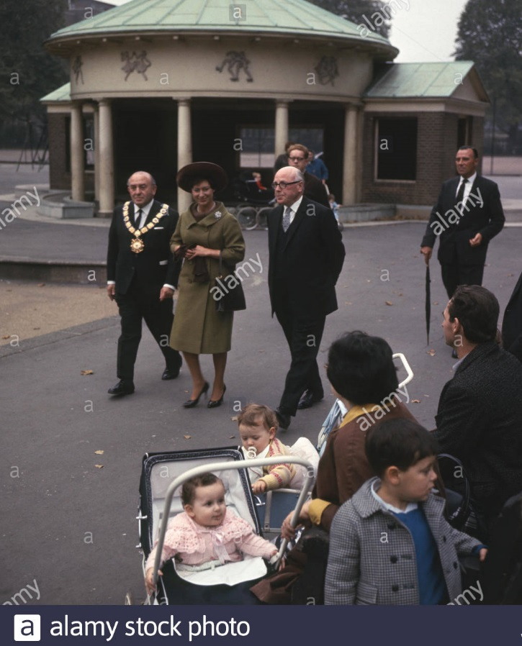
The Word Blind Centre for Dyslexic Children (1963-1972)
Opened by Princess Margaret (R) in Coram’s Fields, Bloomsbury
Reflected the coalescing of research interest in dyslexia in Britain
First director, Alex Bannatyne; later, Sandhya Naidoo (L), who served until its closure
Naidoo’s landmark book: Specific dyslexia: The research report of the Invalid Children’s Aid Association Word Blind Centre for Dyslexic Children

Slide 4
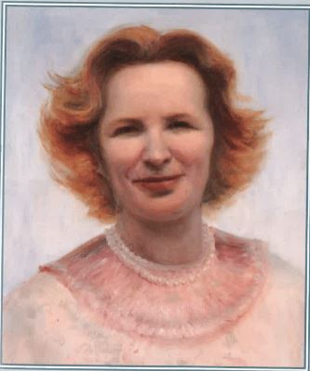
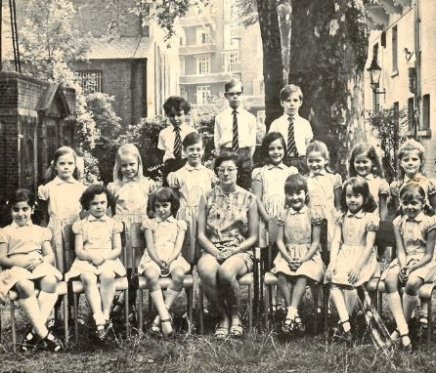
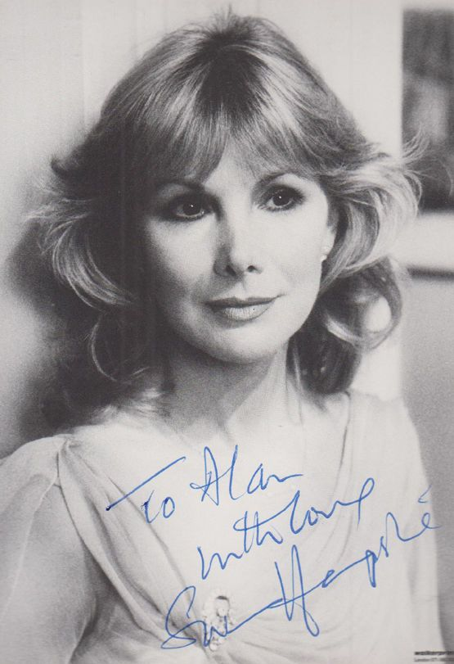
Dyslexia, care and the role of mothers (1940s-)
L to R: June Hampshire; a class at the Hampshire School (1946-); Susan Hampshire

Slide 5
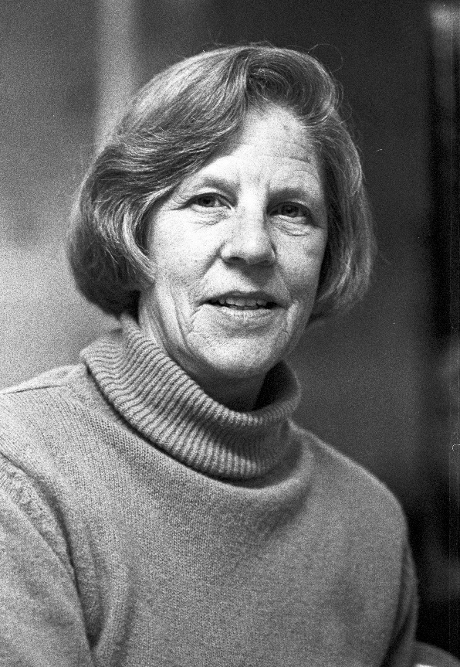
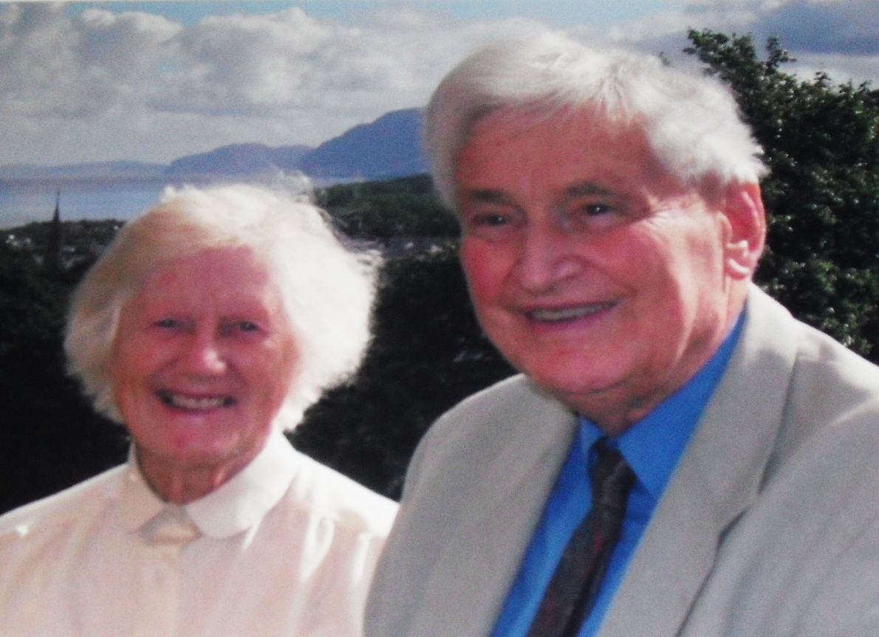
Gender, class and the institutionalisation of dyslexia (1960s-)
L to R: Helen Arkell; Daphne Hamilton-Fairley; Tim and Elaine Miles

Slide 6
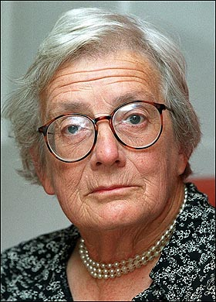
The Warnock Report on special educational needs (1978)
‘The hostility in the department of this concept was manifested by the instruction we were given when we were set up at the beginning of ’74 when I was summoned by the person in the Department who was responsible for the committee… He said, ‘You should not suggest that there is a special category of learning difficulty called dyslexia’ (Baroness Warnock, R)
First use of the term ‘special educational needs’
Influenced by landmark research on reading difficulties from the Isle of Wight studies (1964-1974), led by Mike Rutter and Bill Yule
Later, the government used the Warnock Report’s disinclination toward grouping children to stall parliamentary questions, saying that they could not, as such, recognise the particular category of ‘dyslexic children’

Slide 7
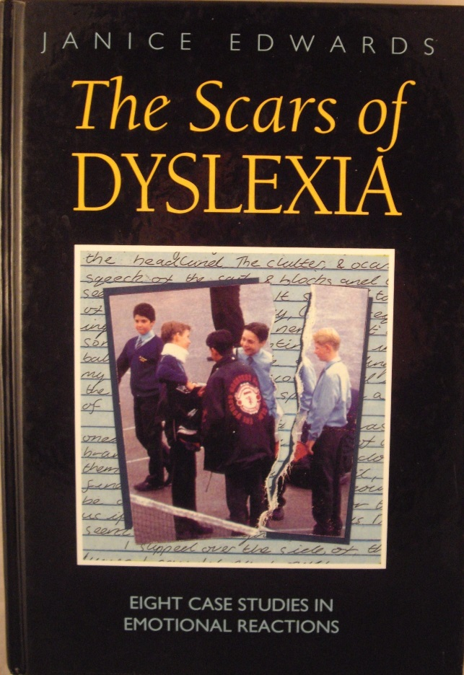
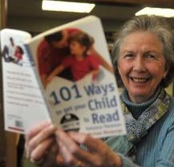
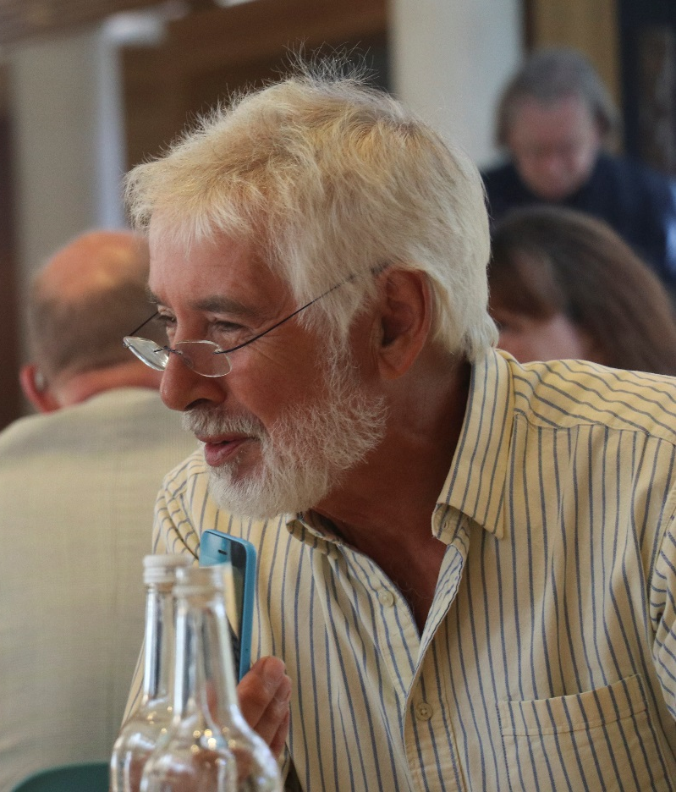
The ‘scars of dyslexia’ and the provision of emotional support
From L to R: The Scars of Dyslexia by Janice Edwards; Patience Thomson; Bill Watkins

Slide 8
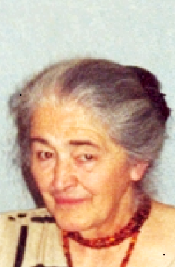
Emotion, dyslexia research and the science of reading
From L to R: Ann Cooke; Margaret Newton; Maggie Snowling

Slide 9
Conclusion
Worried mothers? The importance of gender and a historical perspective in interpreting current debates around the ‘dyslexia myth’
Dyslexia as a ‘construct’ that meets ‘the social, psychological, political and emotional needs of multiple stakeholders’ (Elliott and Grigorenko, 2014), but not only…
Questions

